Slide 1
The 3 pillars of sustainability
Understanding Environmental, Economic, and Social Sustainability

Slide 2
What is Sustainability
“Sustainability ensures we meet our needs today without compromising the ability of future generations to meet theirs.”
• Discussion Prompt: “What does sustainability mean to you?”

Slide 3
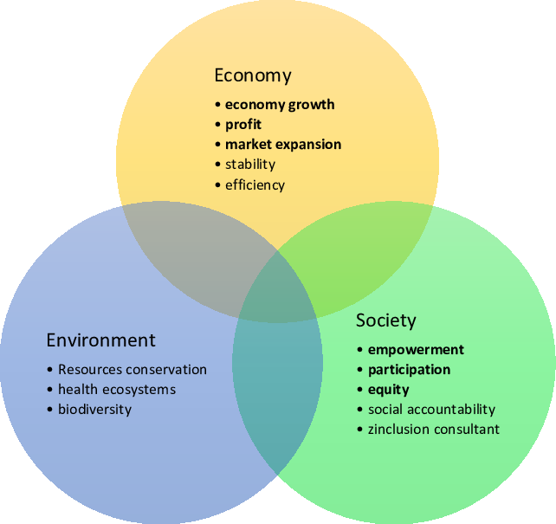
The Three Pillars
of Sustainability

Slide 4
Environmental Sustainability
Focus on the conservation and responsible use of natural resources (air, water, land, biodiversity).
• Key examples: Renewable energy, recycling, and reducing carbon emissions.
• Case Study: Costa Rica’s focus on renewable energy—running on 99% renewable energy since 2015. VIDEO
• Discussion Prompt: “Can you think of examples in your community where environmental sustainability is practiced?”

Slide 5
DEFINITION
Sustainability is a social goal for people to co-exist on Earth over a long period of time. Definitions of this term are disputed and have varied with literature, context, and time.[2][1]
Sustainability usually has three dimensions (or pillars): environmental, economic, and social.[1] Many definitions emphasize the environmental dimension.[3][4]
This can include addressing key environmental problems, including climate change and biodiversity loss. The idea of sustainability can guide decisions at the global, national, organizational, and individual levels.
UNESCO distinguishes the two like this: "Sustainability is often thought of as a long-term goal (i.e. a more sustainable world), while sustainable development refers to the many processes and pathways to achieve it."[7]

Slide 6
Economic Sustainability
Definition: Ensuring economic growth while preserving the environment and improving quality of life.
• Key examples: Green jobs, sustainable business practices, fair trade.
• Case Study: Patagonia’s business model of repair and reuse to extend product life. VIDEO
• Discussion Prompt: “What are some businesses in your area practicing economic sustainability?”

Slide 7
Social Sustainability
• Focus on maintaining social well-being and equity, access to resources, human rights, and community development.
• Key examples: Labor rights, access to education, healthcare, and safe working conditions.
• Case Study: Scandinavian countries’ focus on work-life balance, social welfare programs, and reducing inequality. VIDEO
• Discussion Prompt: “How is your community supporting social sustainability?”

Slide 8
How the pillars interact?
Example: A wind farm (environmental) providing local jobs (economic) and clean energy to underserved areas (social).
• Discussion Prompt: “Can you think of a real-life situation where the pillars overlap in your community?”

Slide 9
Identifying Local Sustainability Challenges
Task: Identify one sustainability challenge in your community related to any pillar.
Task: Propose solutions that address environmental, economic, and social aspects.
Discussion Prompt: “What challenges does your community face when it comes to sustainability?”
work in groups of 5 ppl
TIME: 15 min
Materials: Use any materials

